Slide 1
Site collection and site provisioning with app model
Name
Title
Company

Slide 2
Agenda
Hybrid models for site provisioning
Site provisioning patterns
Updating existing site collections
Site provisioning with CSOM

Slide 3
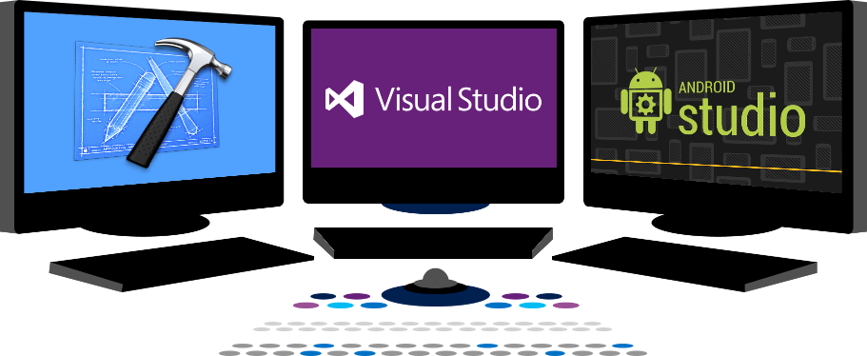














Vision
EXTEND OFFICE EVERYWHERE
CONNECT TO OFFICE 365 SERVICES
BUILD USING AN OPEN PLATFORM
Delve
z
Users and groups
Files
Mail
Calendar
My Apps
Video Portal
Contacts
Office Graph
Presentations
Documents
Spreadsheets
Lync
OneNote
Yammer

Slide 4
Recommendations
Do not use site or web templates
Use Remote Provisioning pattern
Updates using Remote Management pattern
Deploy artefacts without features
Notes:
Vesa

Slide 5
Site provisioning models in SharePoint

Slide 6
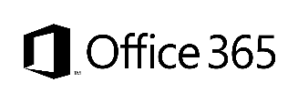
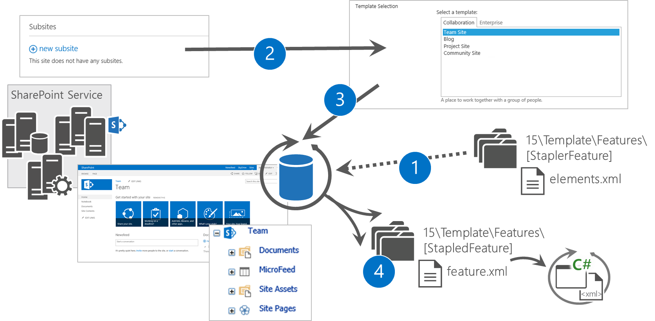
Feature stapling
Modify oob site definition provisioning model
Key objective
Extend site provisioning with out of the box site definitions
Challenge
Cannot be used to bring new template options
Only available in Office365 at site collection scope using Sandbox Solutions
Notes:
Vesa

Slide 7
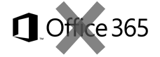
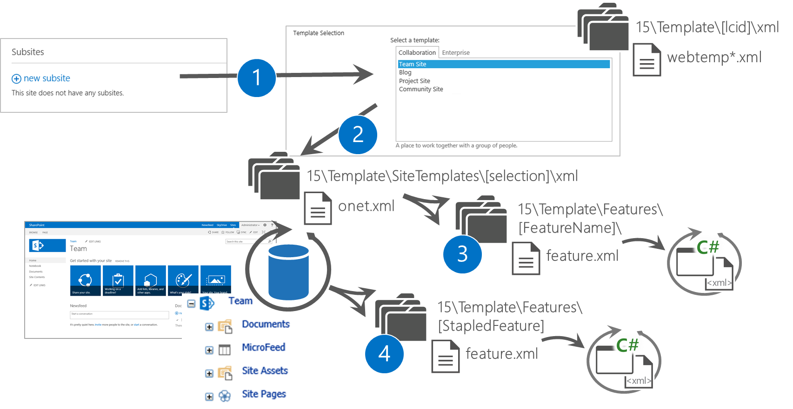
Site definition provisioning process
Classic templating system available since 2003 (sortof) or 2007 (for real)
Key objective
Provide new site options to be available for end users
Same capabilities as for out of the box site definitions
Challenge
Impacts on major version upgrade
Cannot be supported in Office365
Deployed at farm level
Notes:
Vesa

Slide 8
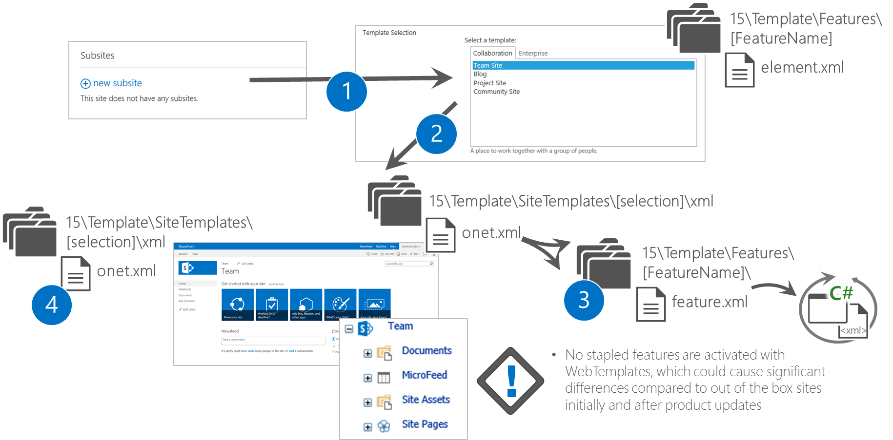
WebTemplate provisioning process
Introduced in 2010 initially for site templates, but can be used “manually” as well
Key objective
Provide new site options to be available for the end users
Site associated to out of the box site definition
Challenge
Have to be updated with minor version updates to the farm
Causes significant maintenance challenges due complete replacement of oob site definition
Supported in site collection level in Office365
Notes:
Vesa

Slide 9
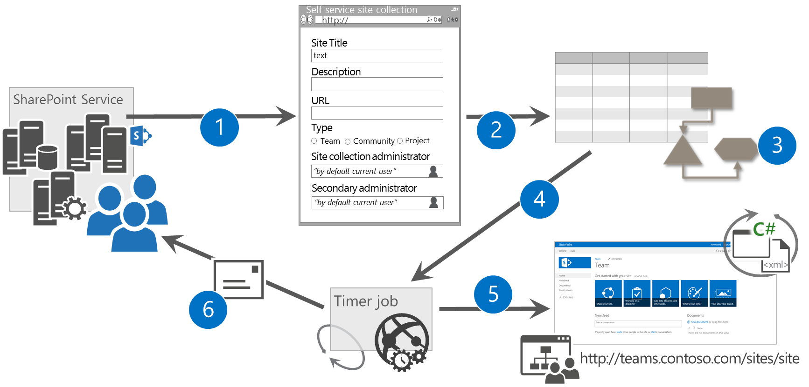
Full server side custom solutions
Pretty common solution for custom self service site collection creation
Key objective
Provide self service and polished site collection creation opportunity for end users
Can be extended with workflows and timer jobs
Challenge
Not supported in Office 365
Requires full trust code
Can be complex to setup and maintain
Notes:
Vesa

Slide 10

Maintenance challenge with web templates
Web Template onet.xml is created by copying team site onet.xml and by adding stapled features to the onet.xml
Significant differences on the outcome unless web template onet.xml has been updated cross site collections with the changes which were also done for out of the box team site.
onet.xml
onet.xml
onet.xml
<xml>
X feature activations
<xml>
X feature activations
<xml>
X feature activations
<< Copy >>
Custom Web Template
Team Site
onet.xml
onet.xml
onet.xml
<xml>
X feature activations
<xml>
X feature activations +2
<xml>
X feature activations +4
Time
Service updates for introducing new capabilities to team sites also using feature stapling
Notes:
Vesa
Risk is that for sites created from the time WE updated the service until the time YOU updated your Templates, these sites will NOT have all of the features

Slide 11
“Web templates were the best option in SharePoint 2010, what has changed?”
Better remote APIs
Much better remote APIs in 2013 provide us full flexibility on the site provisioning without causing additional maintenance challenges
Notes:
Steve

Slide 12

What if…
We would use same model for on-premises and cloud?
Notes:
Steve

Slide 13
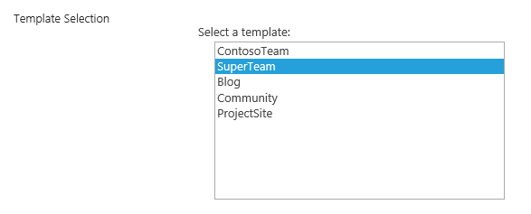
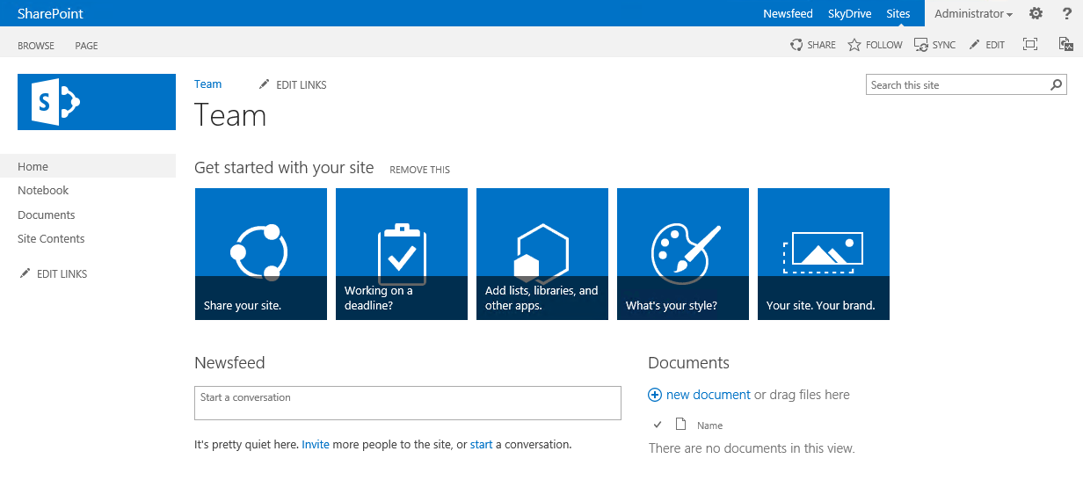
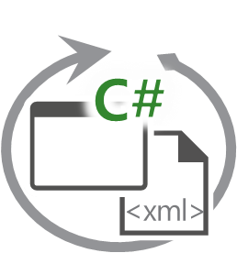
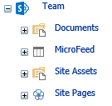
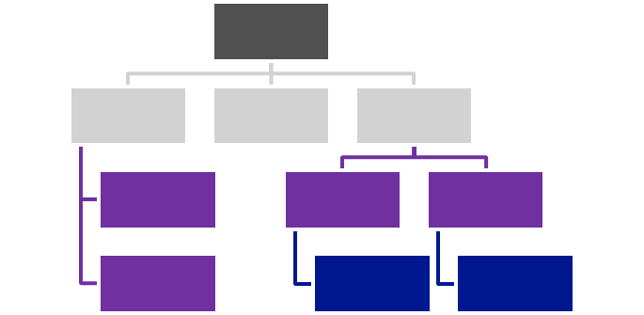

SharePoint Remote Provisioning
SharePoint Service
1
Provider Hosted Apps
3
CSOM / REST
Own app specific configuration
Artefacts
2
Notes:
Steve

Slide 14
“No more feature framework?”
Correct
We recommend remote provisioning patterns rather than feature framework usage
Notes:
Vesa

Slide 15

Site Provisioning Options/Comparison
Site Definition
Site Templates
Web Templates
SP Server side provisioning
Remote provisioning
No Office365
Long term impact on costs
Blocks transition to cloud
Causes significant issues with future migration and upgrade
Poor site collection creation story
Negative impact on upgrades
Causes additional maintenance costs with service updates
Not with publishing features
Poor site collection creation story
Causes maintenance costs with service updates
Provision oob sites, but modify them based on user selection and requirements
Standardization of site creation in code
No Office365
CSOM supports creation of site collections for on-premises and cloud
Standardization of site creation in code
Can be done from any external system
Options
Support in cloud
Options available
Good
Fair
Average
Good
Excellent
Cost impact (short and long term)
Notes:
Vesa
For more information on provisioning sites and associated terminology see:
SharePoint 2010 and web templates, http://blogs.msdn.com/b/vesku/archive/2010/10/14/sharepoint-2010-and-web-templates.aspx
Site provisioning techniques and remote provisioning in SharePoint 2013, http://blogs.msdn.com/b/vesku/archive/2013/08/23/site-provisioning-techniques-and-remote-provisioning-in-sharepoint-2013.aspx

Slide 16
Site provisioning with app model

Slide 17

Site Collection Creation from Apps
What
Provision new site collections from app side
Why
Can be used to override out–of–the–box self-service site collection creation form
Can be used to integrate additional functionalities as part of the provisioning
How
Office365 has separate downloadable that includes the needed CSOM elements to provision sites
After 2014 April CU, natively supported for on-prem as well.
Notes:
Vesa

Slide 18
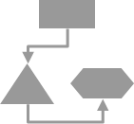
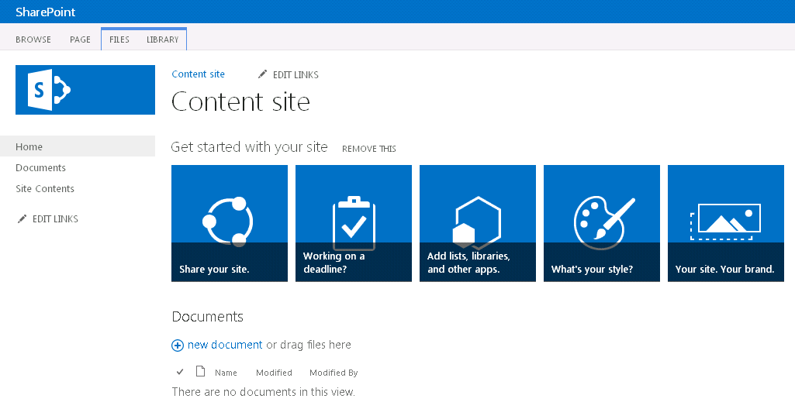
Async provisioning model
Provider Hosted Apps
2
SharePoint Service
1
3
4
6
Remote timer job
5
https://contoso.sharepoint.com /sites/site
Notes:
Vesa

Slide 19
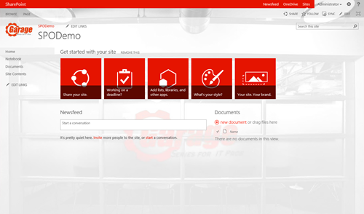
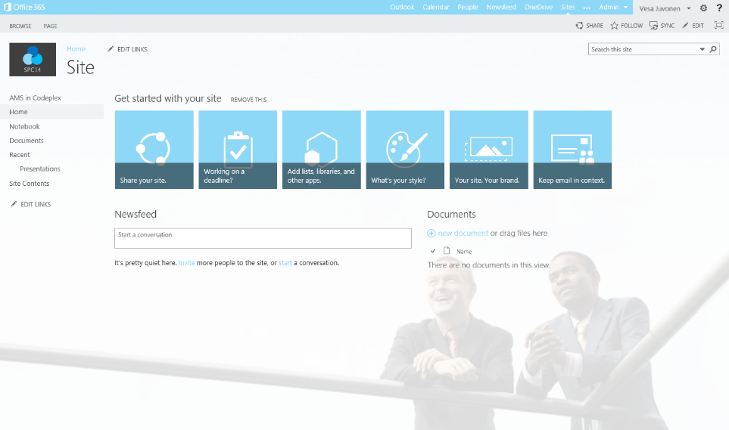
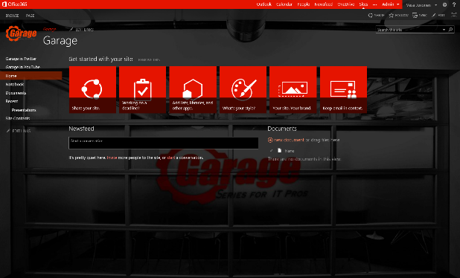
Provisioning time logic
Initial provisioning based on the out of the box site. Usually either team site or publishing site.
Assets are uploaded from the provisioning engine using CSOM/REST
3
Project site
1
2
Remote timer job
3
Assets and configuration
Organizational
Apply the needed changes (configurations etc.) on top of the out of the box site based on the user selection.
This is the specialization part, but since we start from oob site, we always get the latest improvements to it as a base line.
Branding Images
Master Pages
Page Layouts
Other settings
3
Workgroup
Notes:
Vesa

Slide 20
“So, Now I have to write an entire custom Engine for this?”
Not Necessarily
If your model today is to have someone create the site, and then run powershell or feature activations, etc.. That is the “Mechanical Turk” of remote site provisioning… still applicable pattern if you should so choose.
Notes:
Steve

Slide 21
Site collection provisioning
Demo
https://github.com/OfficeDev/PnP/tree/master/Samples/Provisioning.Cloud.Async

Slide 22
Sub Site Creation with Apps
What
Create sub sites in the site collections using app pattern
Why
Provide alternative templates that are all based on out–of–the–box site definition, but can be altered based on customer requirements
Filter what options are shown for end users when they create sub sites
How
Native API support in CSOM
You can also override the out–of–the–box sub site creation experience with your app
Notes:
Steve

Slide 23
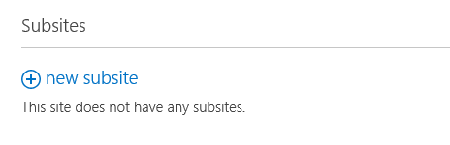
Remote provisioning process sub sites
1
SharePoint Service
Provider Hosted Apps
CSOM / REST
3
2
4
Own app specific configuration
Artefacts
Notes:
Steve

Slide 24
Sub site provisioning
Demo
https://github.com/OfficeDev/PnP/tree/master/Samples/Provisioning.SubSiteCreationApp

Slide 25
Hybrid patterns for provisioning

Slide 26
Hybrid Provisioning Patterns
What
Provision sites cross on-premises and cloud based on the business requirements
Why
Take advantage of cost efficiency in the cloud, but still provision some sites to on-premises, if needed
How
Use remote APIs to provision sites to specific environment as needed
Notes:
Steve

Slide 27
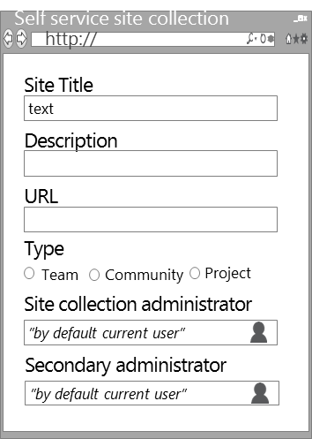
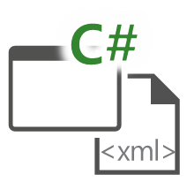
Hybrid self service pattern – classic
Contoso
Internal Users
SharePoint Service
3
1
Provider hosted Apps
http://contoso.sharepoint.com/sites/site
2
Operations are driven from the on-premises.
Integration to cloud is pretty simple with the tenant CSOM.
http://teams.contoso.com/sites/site

Slide 28
Cloud driven hybrid
Contoso
SharePoint Service
Users
2
1
http://contoso.sharepoint.com/sites/site
http://teams.contoso.com/sites/site
Provider Hosted Apps
4
Operations are driven from the cloud.
Connectivity from cloud to on-premises using service bus.
Service Bus
3

Slide 29
Provision sites to on-prem from Azure
Demo
https://github.com/OfficeDev/PnP/tree/master/Samples/Provisioning.Hybrid.Simple

Slide 30
Updating site collections after initial provisioning

Slide 31
Updating Existing Sites
What
Update branding and other settings in the sites after they are created based on new requirements
Why
It’s common that there has to be some adjustment done to the site sites, which have been previously created
How
Provision shared static elements like images, CSS files, and JavaScript files to one location and reference them from sites as needed with relative path
Loop through the sites and update them one by one using remote provisioning model
Notes:
Vesa
NOTE: This can also include common governance tasks – if you need to enforce settings, track user changes, etc, you will need to scan through the sites to accomplish this. You should consider placing the governance and update actions into a common process if you have both requirements.

Slide 32
So I would have to loop through all sites and update stuff one by one?
Yes.
This can take a while with thousands of sites, but there’s no down time for doing this. You can also pinpoint specific sites to be updated first if needed.
Notes:
Vesa
NOTE: This is not altogether that different than what you did on prem with upgrade actions and the like. EXCEPT now you don’t have to take the Content DOWN when doing the upgrades, etc.

Slide 33
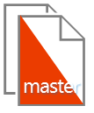

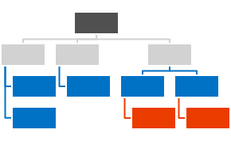



Centralized Asset Deployment
https://Contoso.sharepoint.com /sites/site
https://Contoso.sharepoint.com
<<Reference>>
https://Contoso.sharepoint.com /sites/site2
<<Reference>>
<<Reference>>
<<Reference>>
Provider Hosted App
<<Reference>>
https://Contoso.sharepoint.com /sites/site3
<<Reference>>
Notes:
Vesa
Static assets like images, JS files, and CSS files are deployed together with the master page and asp files to the root site collection of the a web application or a tenant.
Dynamic files like master pages and other asp pages are deployed to the each site collections.
Static files are referenced from the root site collection using relative links.
Provides one location to change most of the functionalities and there’s no need to deploy all the image, CSS, or JS files to each of the site collection.

Slide 34
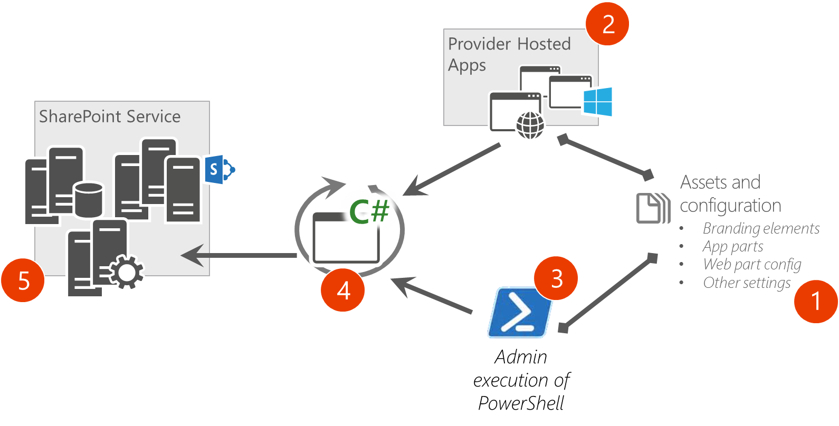
Updating Sites Afterwards Reference architecture for remote site management
Implement branding controlling logic to a reusable component, which can be called from the app and from other solutions
Provides reusability and easy maintenance
Could also be PowerShell scripts
Notes:
Vesa

Slide 35
Recommendations
Do not use site or web templates
Use Remote Provisioning pattern
Updates using Remote Management pattern
Deploy artefacts without features
Notes:
Vesa

Slide 36
Questions?

Slide 37

aka.ms/OfficeDevPnP
Transform your code
Providing App Model Patterns for common scenarios Open source and based on community contributions Constantly evolving set of material for reuse
100+ Visual Studio projects
Common scenarios Branding Site provisioning Remote event receivers
UX component Taxonomy driven navigation And much more…
Patterns and Practices Yammer Group - http://aka.ms/officedevpnpYammer

Slide 38


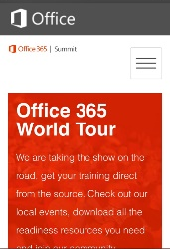
dev.office.com
Sign up
http://dev.office.com/getting-started
Explore
http://apisandbox.msdn.microsoft.com
Get trained http://dev.office.com/training

Slide 39


Feedback
Office 365 Network Share you best practices and join conversations
https://www.yammer.com/itpronetwork
Stackoverflow Ask deep technical questions to a world-wide set of developers
http://stackoverflow.com/questions/tagged/ms-office
UserVoice Provide suggestions of what you want in future versions
http://officespdev.uservoice.com/

Slide 40


© 2015 Microsoft Corporation. All rights reserved. Microsoft, Windows, and other product names are or may be registered trademarks and/or trademarks in the U.S. and/or other countries.
The information herein is for informational purposes only and represents the current view of Microsoft Corporation as of the date of this presentation. Because Microsoft must respond to changing market conditions, it should not be interpreted to be a commitment on the part of Microsoft, and Microsoft cannot guarantee the accuracy of any information provided after the date of this presentation. MICROSOFT MAKES NO WARRANTIES, EXPRESS, IMPLIED OR STATUTORY, AS TO THE INFORMATION IN THIS PRESENTATION.

